Slide 1
Tableau – Dimensions, Measure, Discrete, Continuous

Slide 2
Tableau - Datatypes
Number
Decimal
Whole
String
Date
Datetime
Geographic
Boolean

Slide 3
Tableau – types of connection
Live
Extract

Slide 4
Extensions
twb – Source data not available, XML , Live connection
twbx – source data available, compressed file, Extract connection

Slide 5
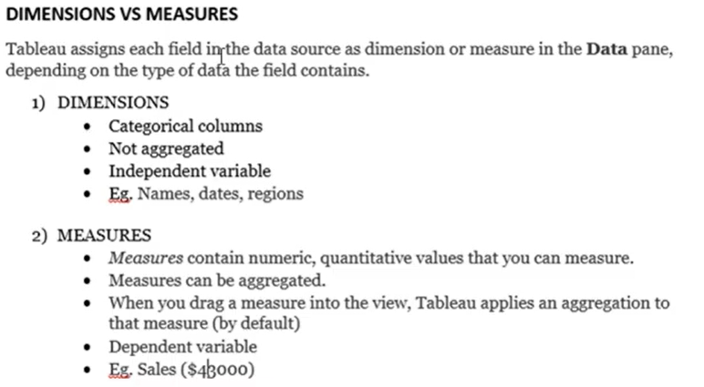
Dimension VS Measures

Slide 6
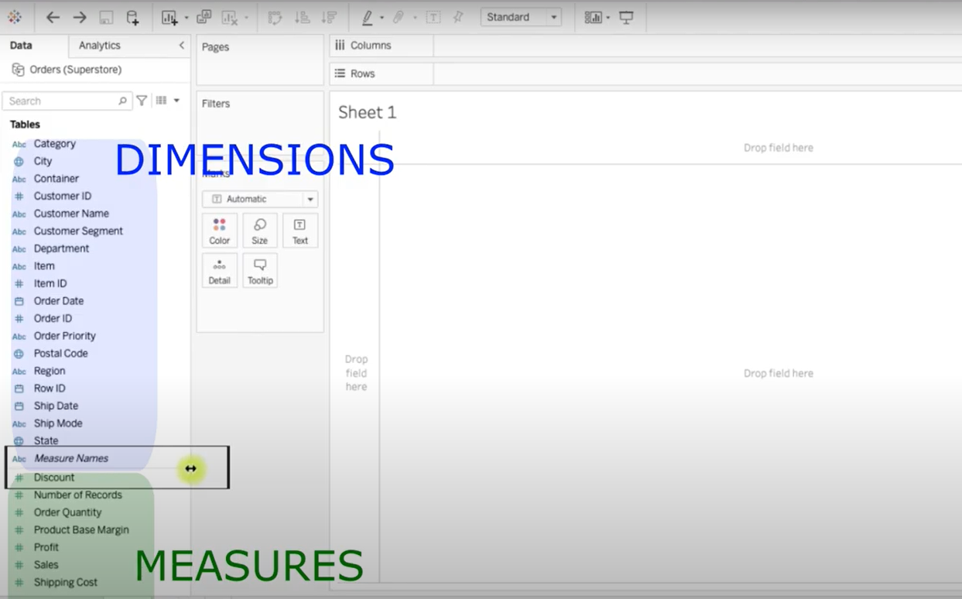

Slide 7
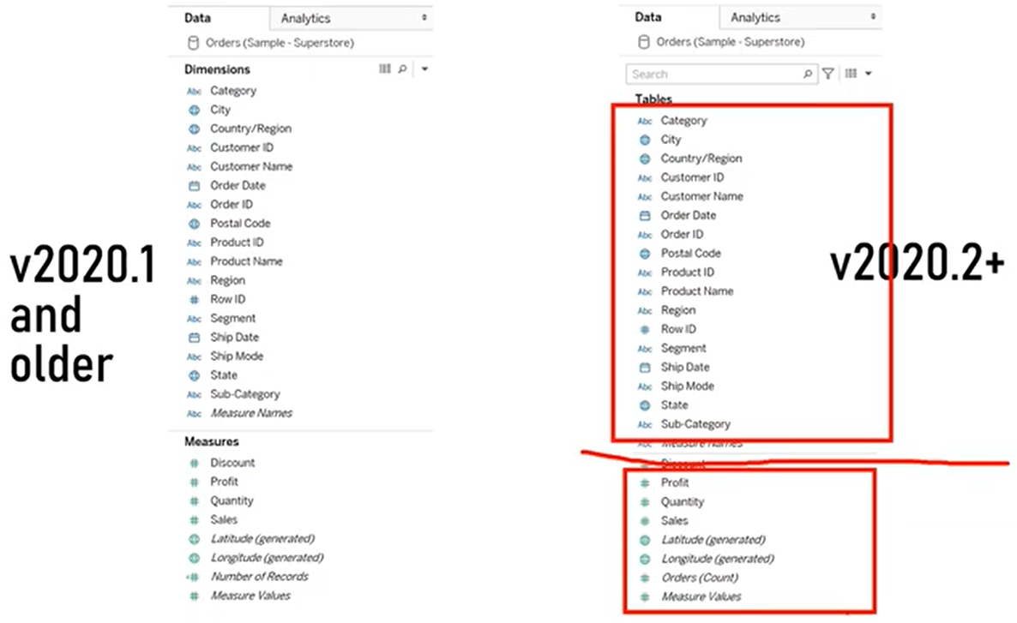
Dimension VS Measures

Slide 8
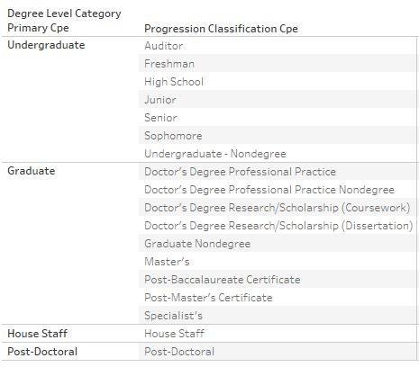
Dimension VS Measures
4
Dimensions
Tableau assigns categorical information as a dimension
Strings, booleans, dates
Dimensions create buckets - they help divide the data

Slide 9


Dimension VS Measures
5
Measures
Tableau assigns quantitative numerical information as a measure
Numbers (integers, floats)*
Measures fill buckets - they are “math” data that help do calculations
*Disclaimer: not all numbers should be measures
- think Student IDs and postal codes
Yes!
No!

Slide 10
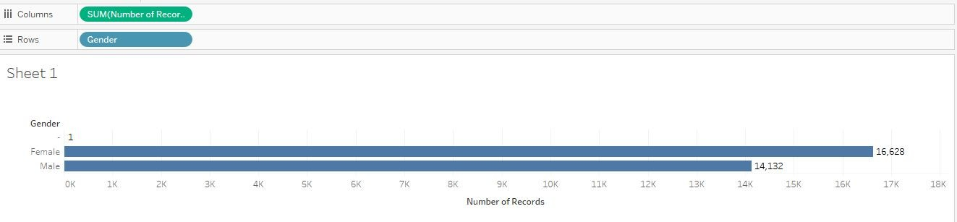
Dimension VS Measures
6
Gender is a dimension
Divides the data into the possible gender options
Number of Records is a measure
Summing the number of records shows us how many students are in each gender option

Slide 11

Dimension VS Measures
7
Measures will be aggregated using some sort of mathematical function
Wrapped in parentheses
Dimensions will not
Color does not distinguish dimensions & measures

Slide 12
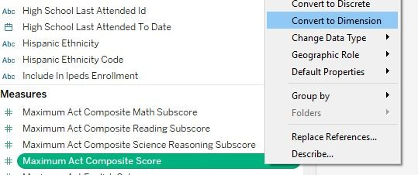
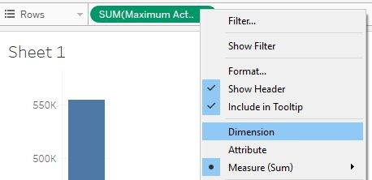
Switching Dimensions and Measures
8
Universally
1. Drag field from Dimensions shelf to Measures shelf (or vice versa) in data pane
2. Right-click on field in data pane and select Convert to Dimension (Measure)
It will now appear in Measure (Dimension) shelf
One-time Only
3. On the viz, right-click and select
Dimension (Measure)

Slide 13
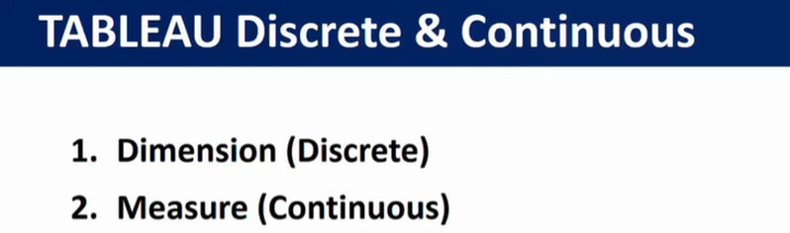
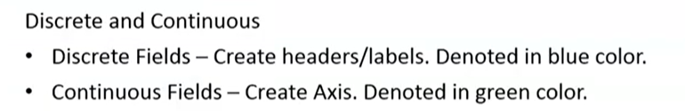

Slide 14
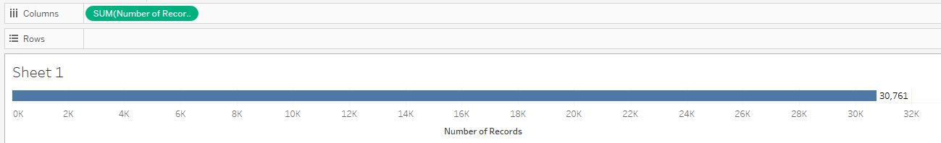
Continuous VS Discrete
9
Continuous
“Forming an unbroken whole, without interruption”
Placing a continuous value on Rows or Columns shelf creates an axis - shows actual and potential values
Continuous data is measured
Measures are assumed to be continuous

Slide 15
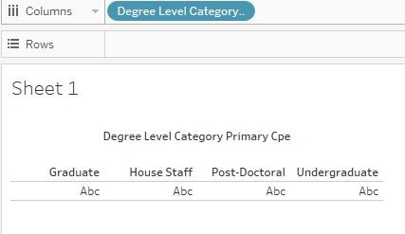
Continuous VS Discrete
10
Discrete
“Individually separate and distinct”
Placing a discrete value on Rows or Columns shelf creates headers
Dimensions are assumed to be discrete
Discrete data is counted
Column Headers

Slide 16
Continuous VS Discrete
11
Gender is discrete
Creates headers for the gender options
Number of Records is continuous
Creates axis to measure the aggregation

Slide 17
Continuous VS Discrete
12
Discrete fields are blue
Continuous fields are green

Slide 18
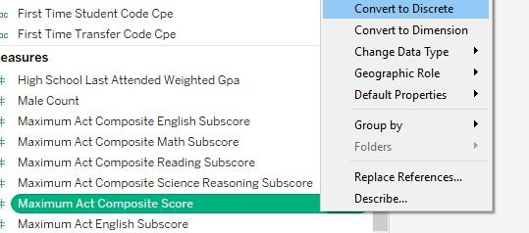
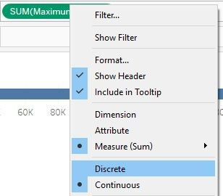
Switching Discrete and Continuous
13
Universally
Right-click on field in data pane and select Convert to Discrete (Continuous)
One-time Only
Right-click on field on the viz and select Discrete (Continuous)

Slide 19
Caution: Dates
14
Dates can be either continuous or discrete
Continuous: represent the chronological progression of time, axis acts as a timeline
Associates every part of date with a particular date
I.e. May 5th, 2017
Discrete: represent the pieces of a date independently
I.e. May is the month, 5 is the day, 2017 is the year

Slide 20
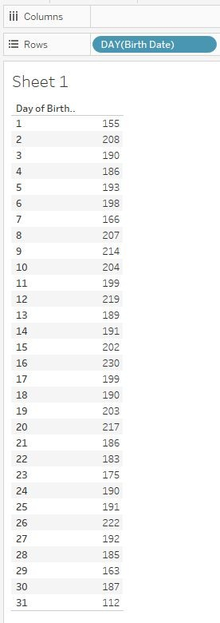
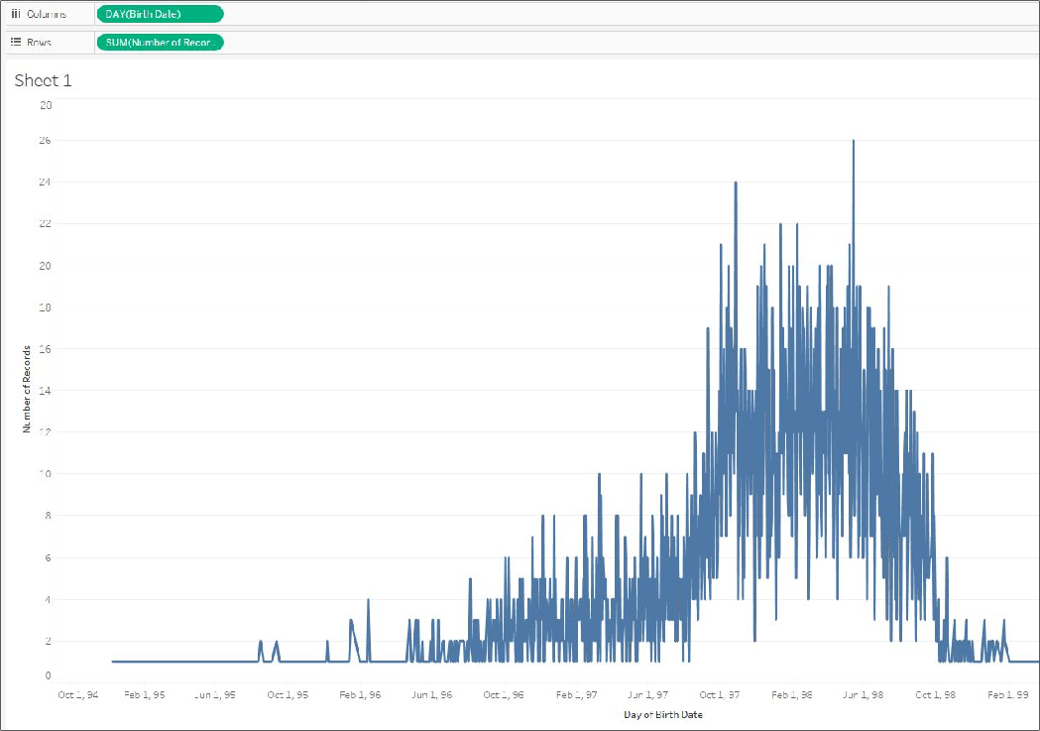
Continuous v. Discrete Dates Example
15
Continuous
Discrete

Slide 21
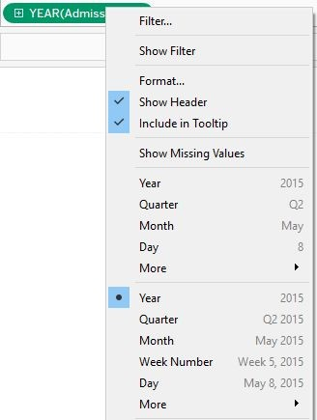
Switching Continuous and Discrete Dates
16
Right-click on date field on viz
Select appropriate date part and representation
Discrete
Continuous

Slide 22
Understanding Measure Names v. Measure Values
17
Fields not in original data source, but provided by Tableau
Allow you to create vizs with multiple measures
Measure Names: a collection of all the names of the measures in one field
Housed under Dimensions since the values are strings
Measure Values: a collection of all the values of the measures in one field
Housed under Measures since the values are measures themselves

Slide 23
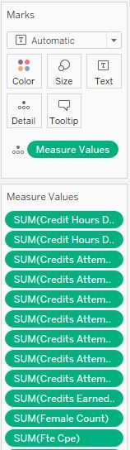
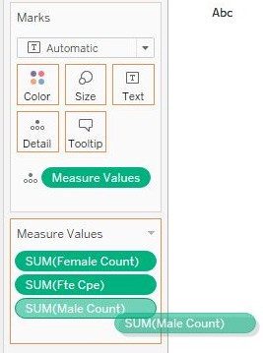
Utilizing Measure Values
18
When adding Measure Values to a viz, a separate shelf appears below the Marks shelf with all the Measures in their default aggregation
Remove or add Measures as necessary by dragging them off/on the shelf

Slide 24
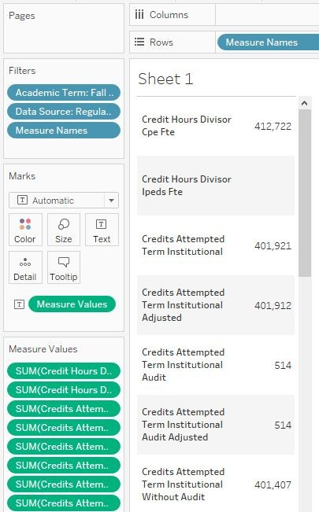

Utilizing Measure Names
19
To display what the Measure Values indicate, Measure Names needs to be on the viz as well
Otherwise, you’ll get this...
Remember: Measure Names is a dimension and, thus, creates buckets to divide the data

Slide 25
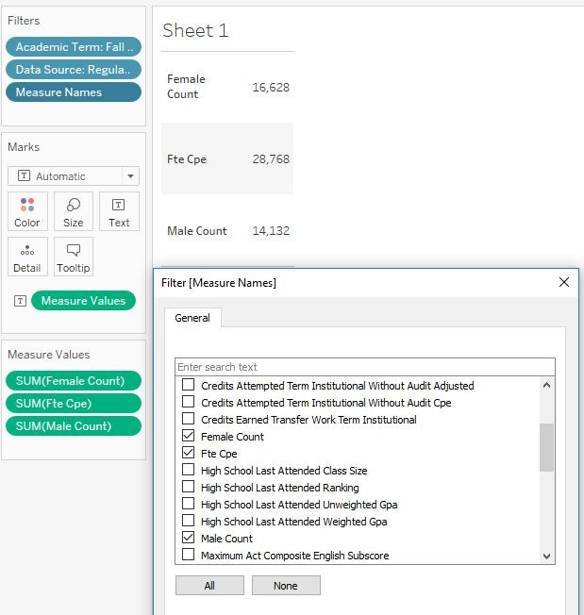
Staying in Sync
20
Once Measure Values is on the viz, Measure Names appears on the Filter shelf automatically
The names chosen to display on Measure Names will stay in sync with the values in Measure Values
An action to add/remove in one will reflect in the other

Slide 26
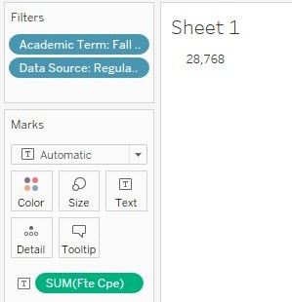
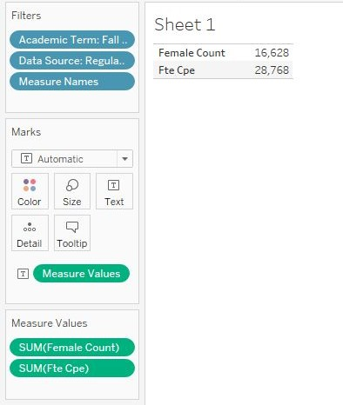
Tip for Measure Values
21
If using a data source with many Measures, but only needing to display a few:
Move one Measure to the text icon on the Marks shelf
Double-click on other Measures to send them to the Marks shelf
Measure Values will automatically appear once second Measure is added

